Slide 1
Logistic Regression
A friendly introduction inspired by StatQuest

Slide 2
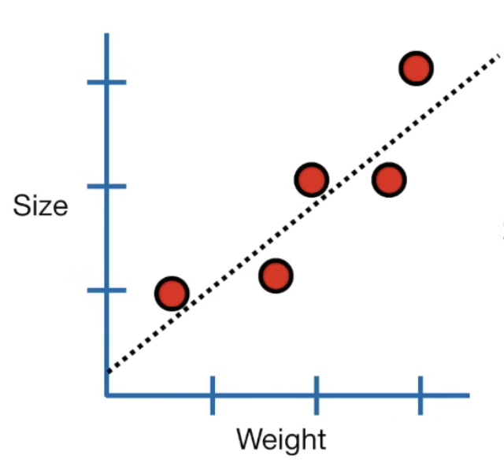
Quick Recap: Linear Regression
Linear regression predicts continuous outcomes.
Example: Predict mouse size using weight → outputs any real number
With a line fit, we can:
Calculate R² to see effect strength.
Get p-values to judge statistical significance.
Predict new values based on the line.
👉 But what if our outcome is NOT continuous? What if it’s just YES/NO (Binary)?

Slide 3
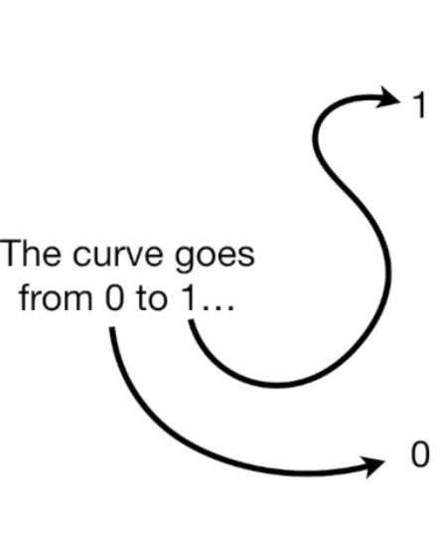
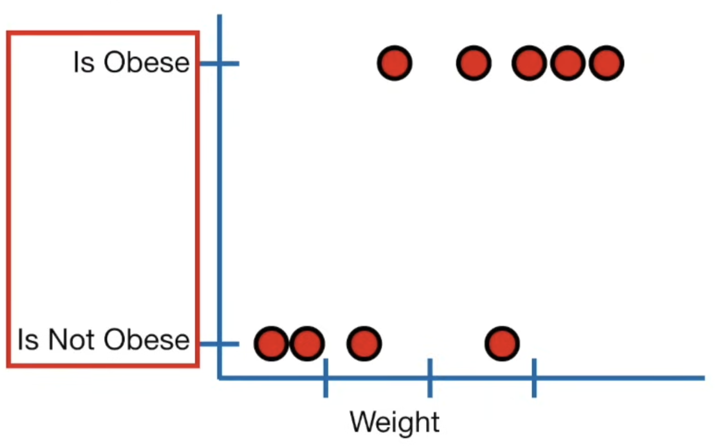
Can we use a mouse’s weight to predict whether it is obese?
Outcome is binary: Obese ✅ or Not Obese ❌ ( Binary )
We’re no longer predicting a number, but a Yes/No classification
And this is exactly what logistic regression is used for.
Logistic Regression predicts True or False outcomes.
Instead of outputting a size or weight, it outputs a probability.
So the Y-axis is always between 0 and 1 → represents P(Obese | Weight).

Slide 4
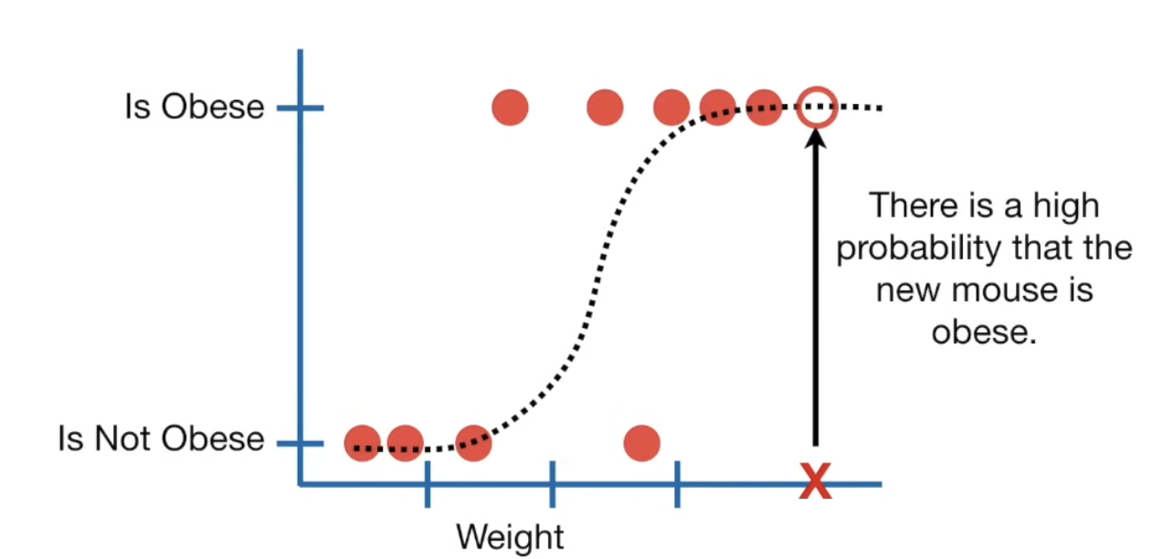
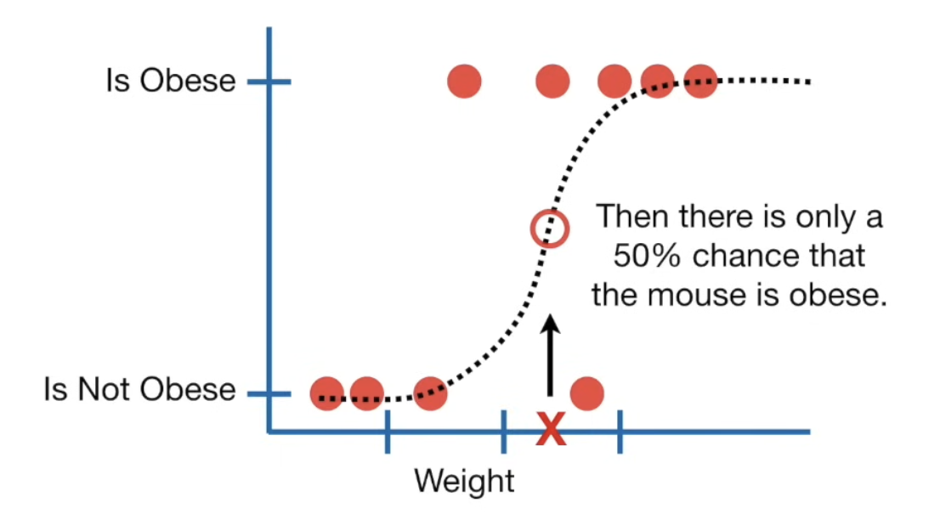
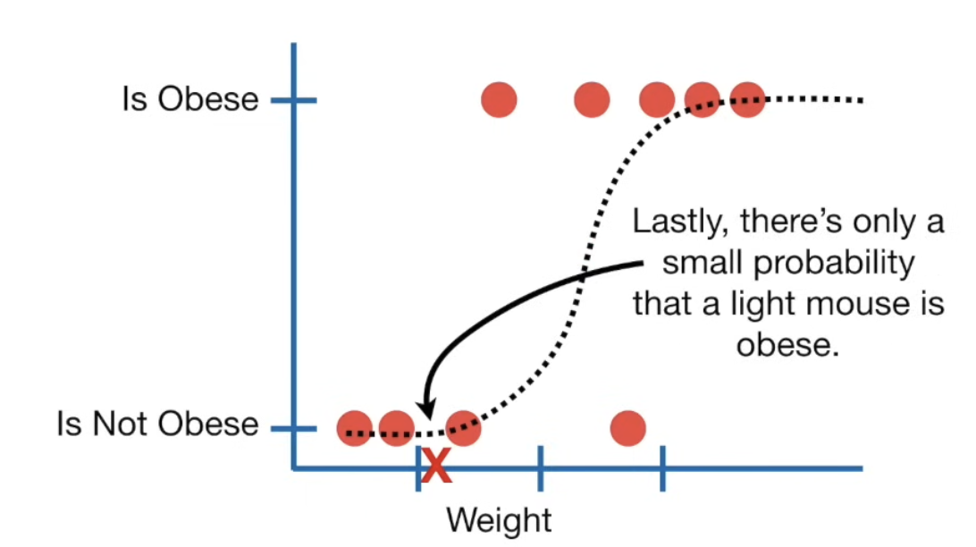
Linear regression draws a straight line. Used to predict value
Logistic regression fits an S-shaped (sigmoid) curve.
Very light mouse → probability near 0
Medium weight → around 0.5
Heavy mouse → probability near 1
Used for classification
If P(Obese) > 0.5 → classify as Obese
Else → classify as Not Obese
Logistic regression does probability estimation + classification in one model.

Slide 5

Logistic Regression Can Use Multiple Features
Just like multiple regression, we can extend:
Obesity ~ weight Obesity is predicted by weight​
Obesity ~ weight + genotype Obesity is predicted by weight and genotype
Obesity ~ weight + genotype + age Obesity is predicted by weight, genotype, and age
Obesity ~ weight + genotype + age + astrological sign Obesity is predicted by weight, genotype, age and astrological sign ( Useless )
👉 It can handle both continuous variables (weight) and categorical variables (genotype - different types of mouse).
In linear regression, we compared simple vs complex models using R².
In logistic regression, R² doesn’t work because we don’t have standard residuals.
Instead, we use Wald test → checks if a variable actually improves prediction.
Example: Astrological sign = totes useless (not helping) → drop it to keep the model clean.

Slide 6
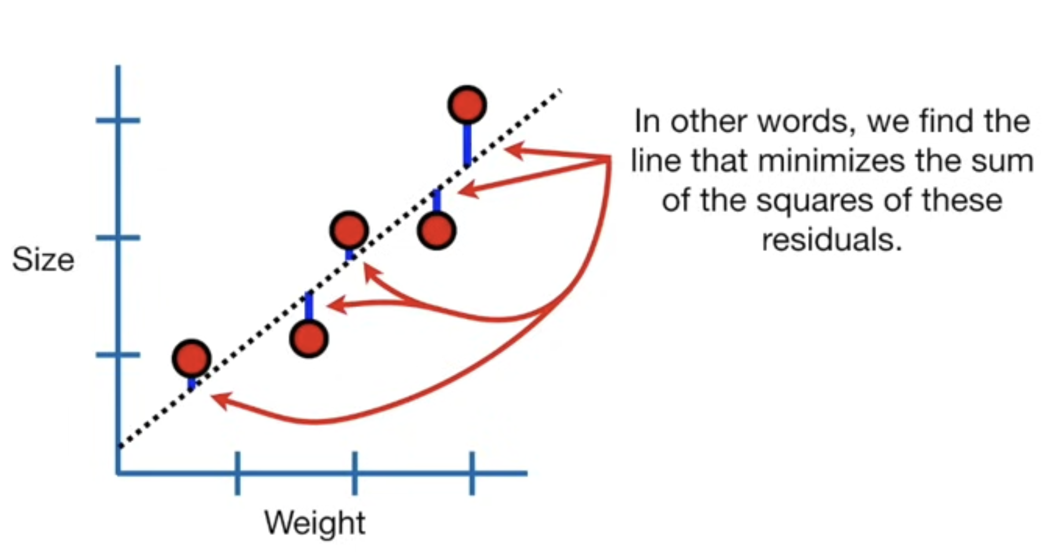
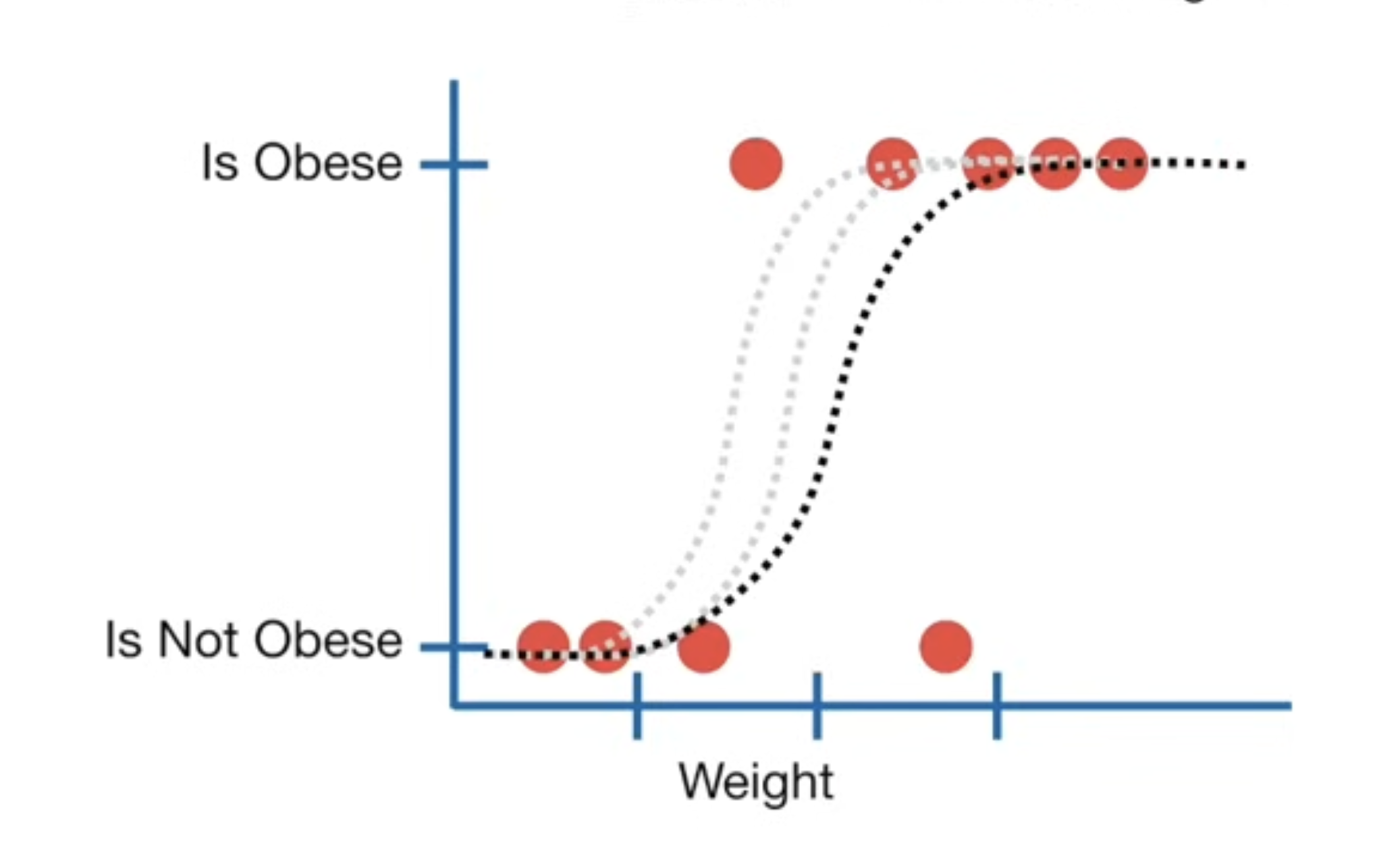
Fitting the Logistic Model
Linear regression uses Least Squares → finds line minimizing squared errors.
Logistic regression uses Maximum Likelihood:
For each mouse, based on weight, the model says: What probability would I assign to it being obese?
Multiply all these probabilities → get likelihood of observing all the data.
Shift the curve slightly, recompute → find the curve that gives the highest likelihood.
That’s the best logistic regression model.

Slide 7
Concept | Linear Regression | Logistic Regression
Output Type | Continuous value | Probability (0 to 1)
Goal | Predict numbers | Classify Yes/No
Model Shape | Straight line | S-curve (Sigmoid)
Evaluation Method | R², residuals | Likelihood, Wald Test
Data Types Supported | Continuous only | Continuous + Categorical
Logistic regression's ability to provide probabilities and classify new samples using continuous and discrete measurements make it a popular machine learning method
It gives probabilities, class labels, and tells us which variables matter.
Clean, powerful, and widely used in medical predictions, spam detection, credit risk, etc.

Slide 8
Hierarchical Clustering
A friendly introduction inspired by StatQuest

Slide 9
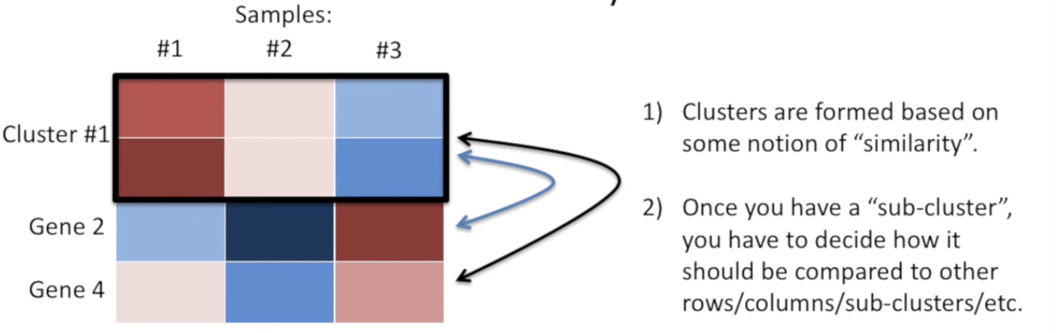
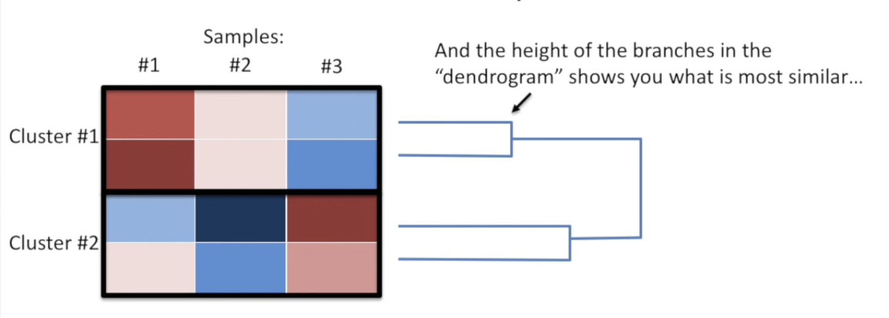
What is Hierarchical Clustering?
A method that groups similar items together step by step.
Often used with heat maps to reorder rows/columns based on similarity.
Helps reveal patterns and correlations visually.
Visual patterns + dendrogram height → great for exploratory data analysis
Defaults in software are usually reasonable to start with
👉 Common in gene expression data, but also used in customer segmentation, document grouping, image analysis, etc.

Slide 10
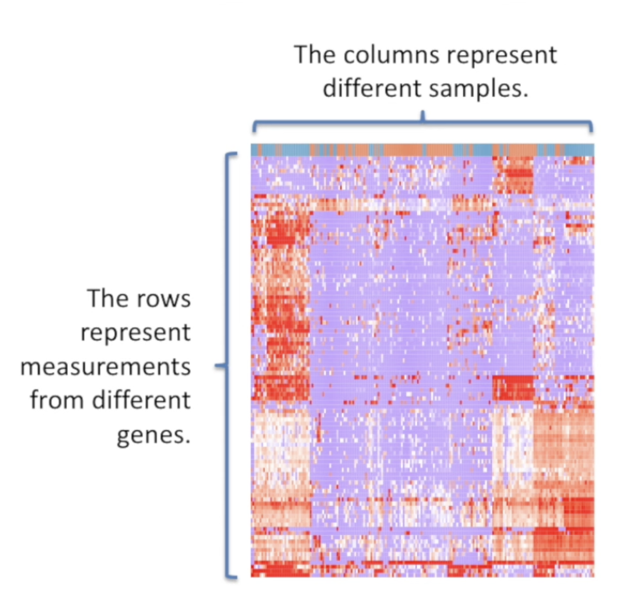
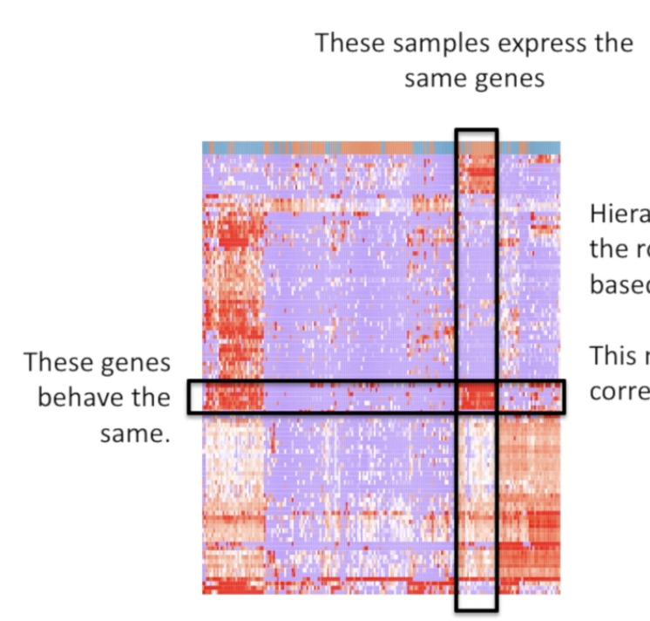
Example Heat Map Setup
Columns = samples
Rows = genes
Colors represent expression levels
Red → high expression
Blue/Purple → low expression
Hierarchical clustering orders the rows and/or the columns based on similarity
This makes it easy to see correlations in the data

Slide 11
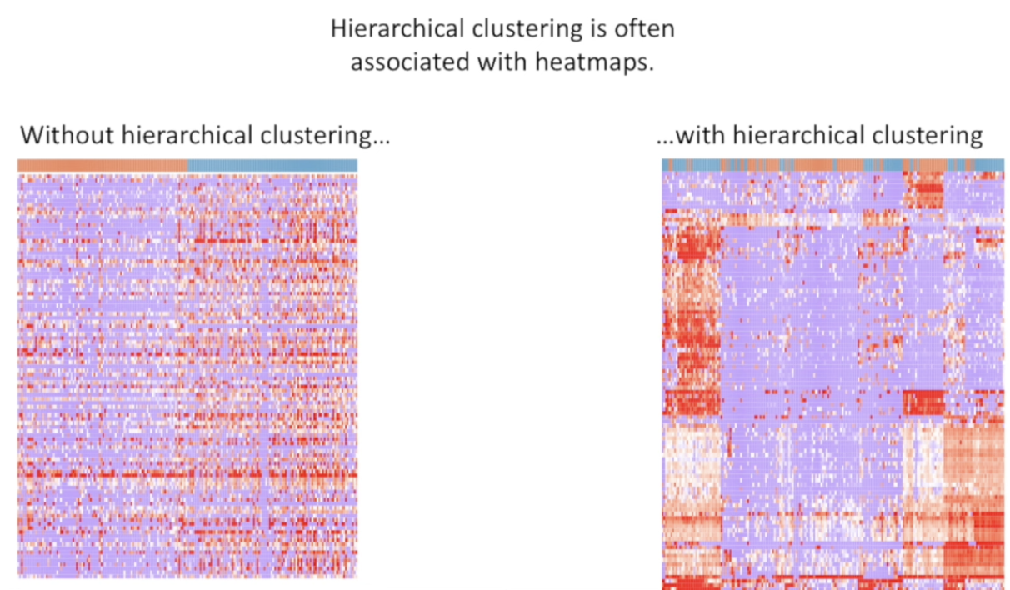
Why Clustering Matters
Without clustering → rows/columns appear random.
With clustering → similar genes/samples are grouped together, making patterns clear. Visual improvement = easier interpretation + insight discovery.

Slide 12
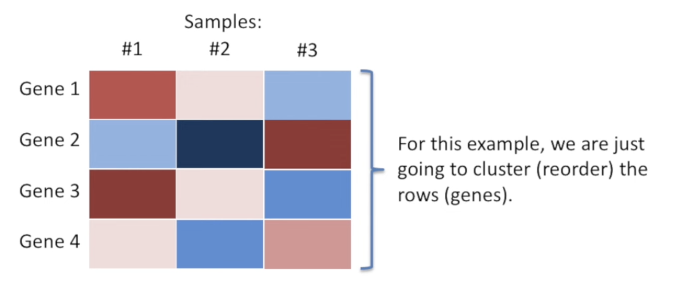
Step-by-Step Example
We have:
3 samples
4 genes
We want to cluster (reorder) genes only (rows).

Slide 13
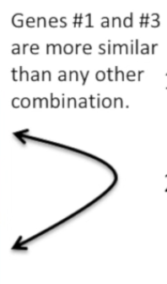
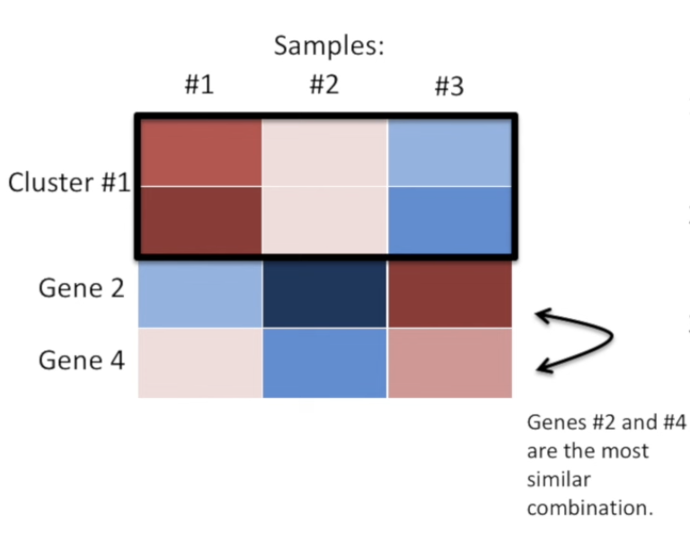
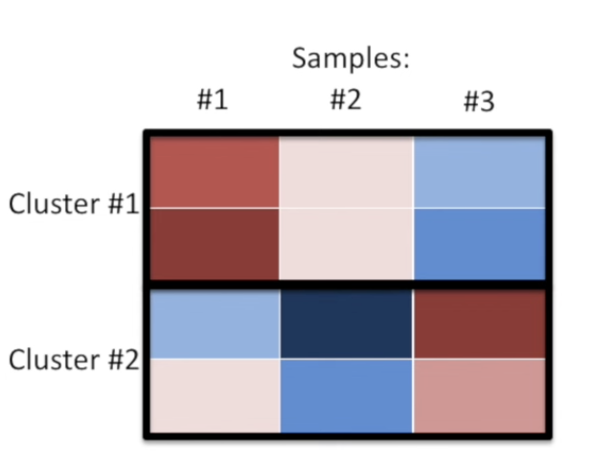
Step 1: We have four different genes, so in total, we have four choose two ways to pair two genes together
Among all those combinations, we want to choose the most similar pair of genes and cluster them together
Step 2: Form First Cluster
Merge the most similar pair first
→ Cluster 1 = {Gene 1, Gene 3}
Step 3: Repeat the Process
Treat each cluster as a new “meta-item”
Now we have three choose two ways to pair two genes together:
Cluster {1,3} vs Gene 2
Cluster {1,3} vs Gene 4
Gene 2 vs Gene 4
Among these three ways to pair two genes, we find that Gene #2 and #4 is closest → merge into a new cluster

Slide 14
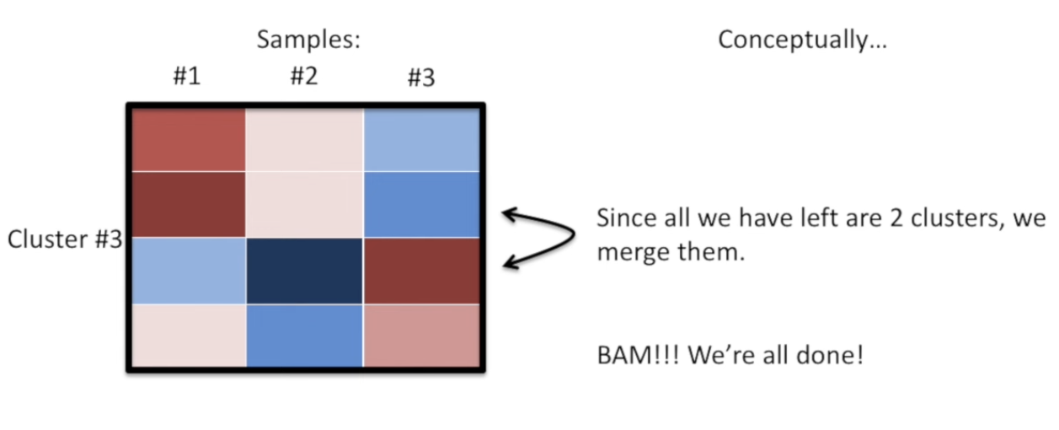
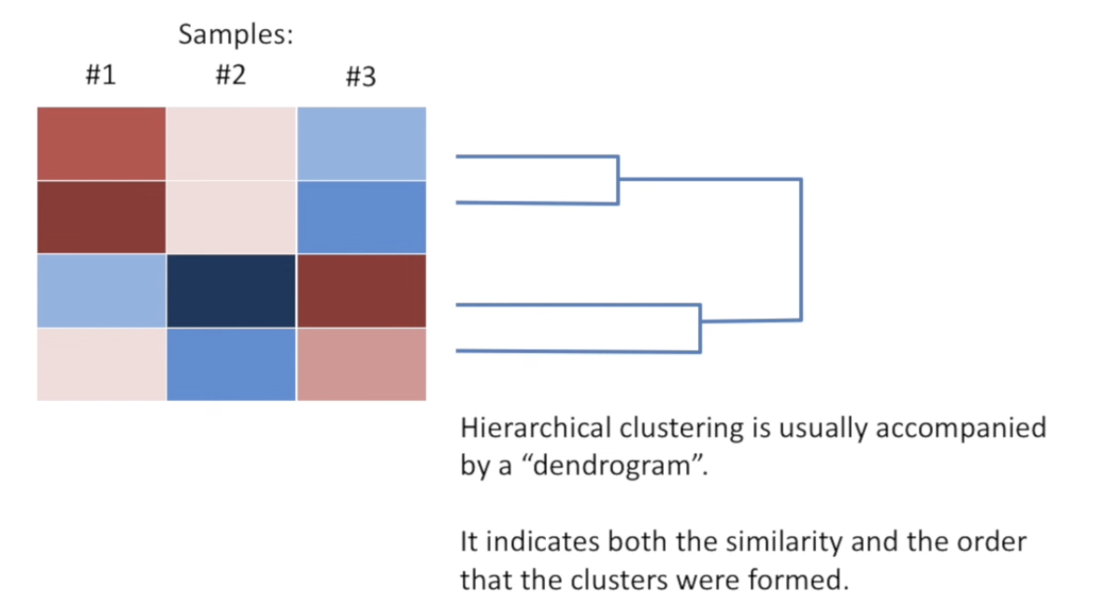
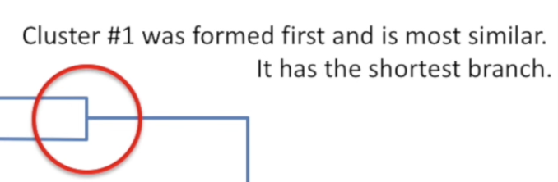
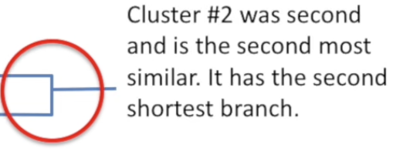
The final merge happens when there are only two groups left
{Gene 1, Gene 3}
{Gene 2, Gene 4}
Merge them into final cluster
✅ Clustering complete
Dendrogram
A tree diagram that shows:
Order in which clusters were merged
Height of branches = how similar they are
Short branch = very similar
Tall branch = merged later = less similar

Slide 15
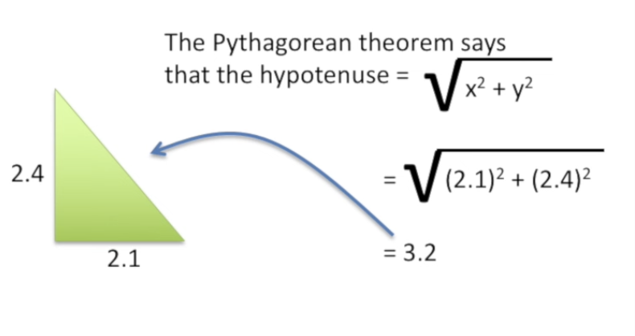
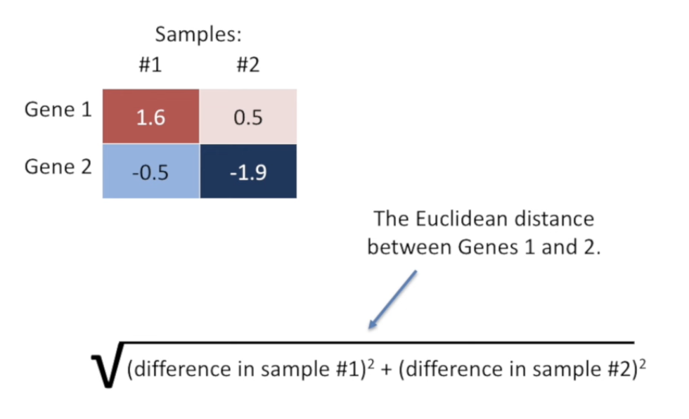
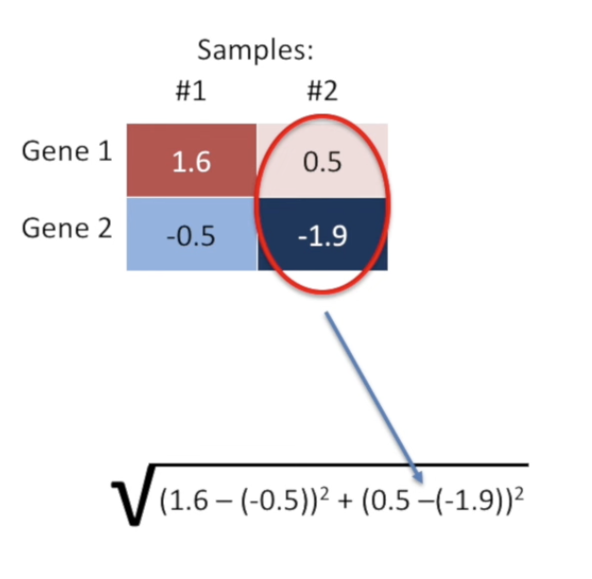
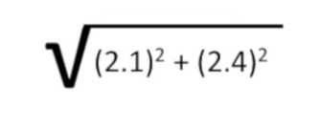
How Do We Measure Similarity?
We need a distance metric to compare genes.
Common default: Euclidean Distance

Slide 16
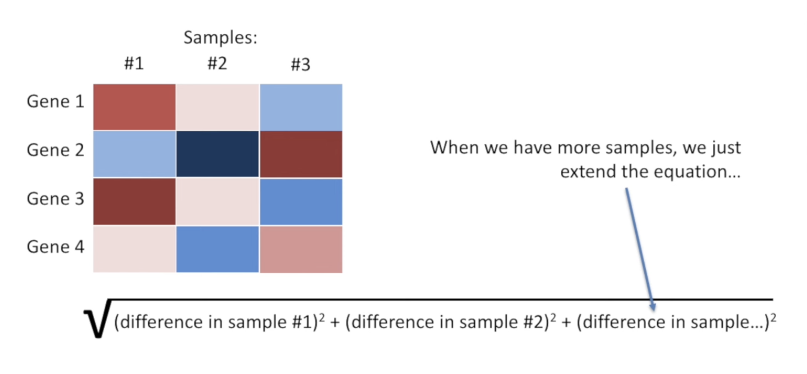
Euclidean Distance with more samples

Slide 17
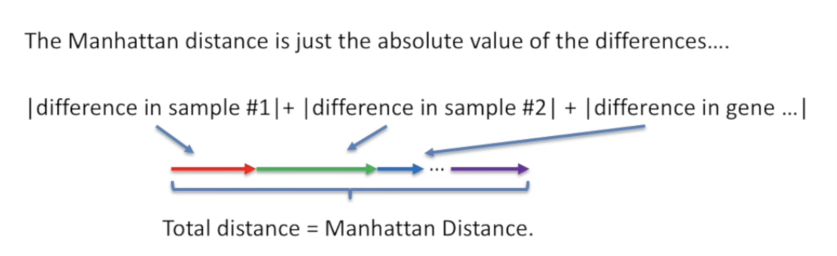
How Do We Measure Similarity?
We need a distance metric to compare genes.
Common default: Euclidean Distance Other methods: Manhattan Distance (Alternative)
Instead of squares → use absolute values
Like moving block by block in a city grid
Gives slightly different clustering results

Slide 18
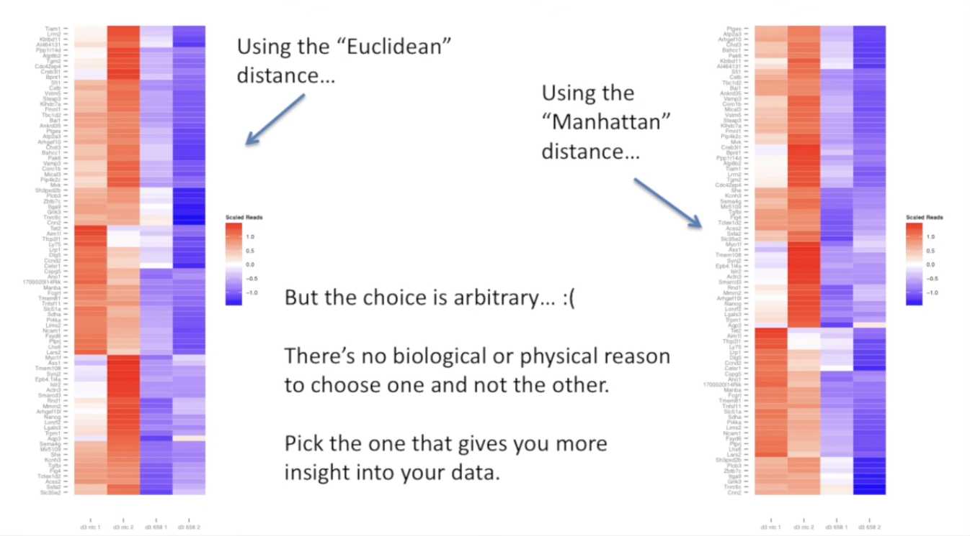
Others methods exist, and choice is arbitrary 👉 Pick the one that gives better insight for your data.

Slide 19
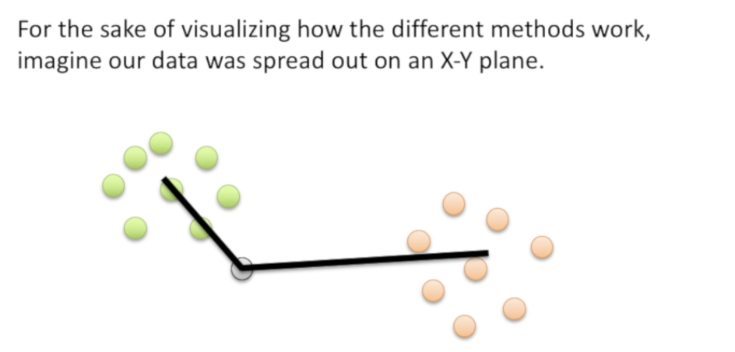
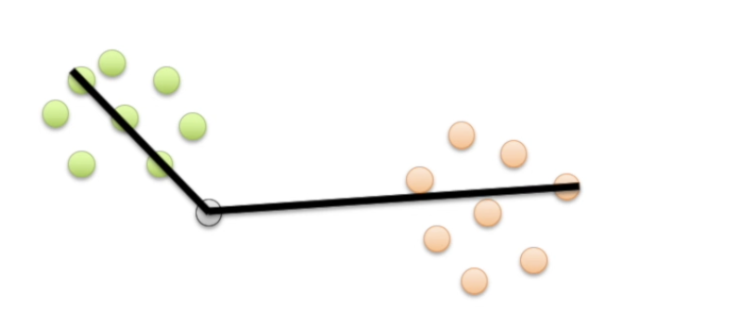
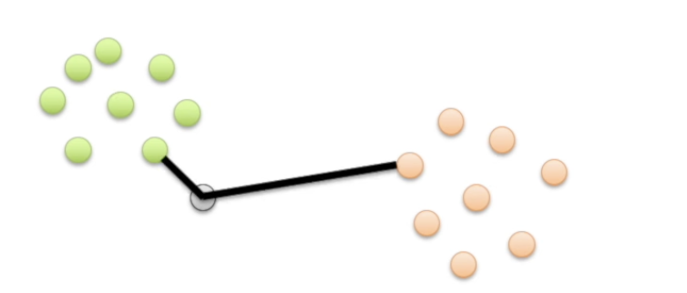
How to Compare Clusters? (Linkage Methods)
Once items join into clusters, how do we compare a cluster vs a gene?
Method | How it compares
Single Linkage | Closest point between clusters
Complete Linkage (default in R) | Farthest point between clusters
Average Linkage | Compare centroids (mean)

Slide 20
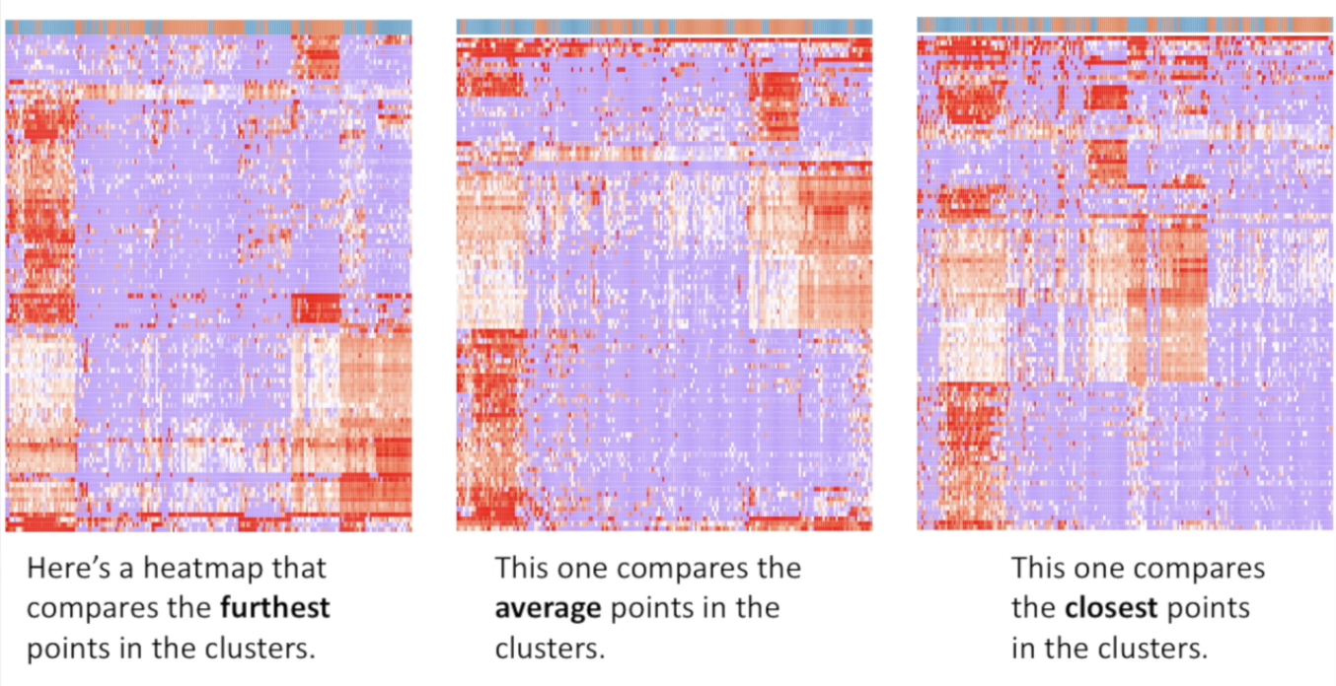
Linkage Affects the Result
Even with the same data:
Single linkage → long chained clusters
Complete linkage → tight, compact clusters
Average linkage → balanced layout
👉 Heat maps may look slightly different depending on method

